Slide 1
Insides Sales Strategy
Jamie Cheng

Slide 2
To increase ancillary sales…
Increase ancillary visibility through an established communication channel with X, Y, & Z teams
Bridge the gap between counselor strategy and product recommendations
Differentiate from competitors by emphasizing our unique value proposition (e.g., comprehensive counseling)

Slide 3
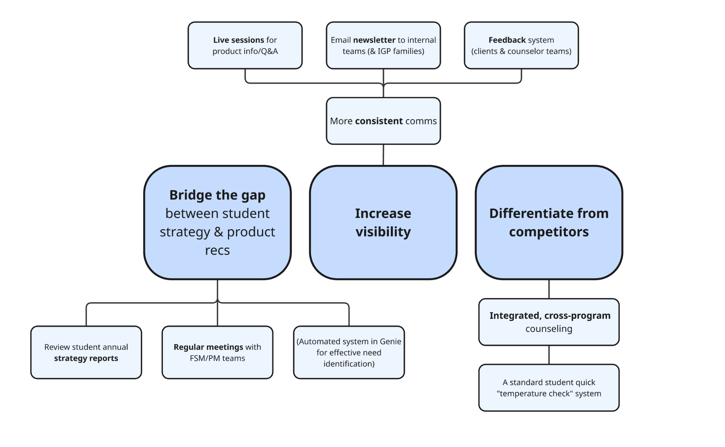
Strategic approach I plan to take…

Slide 4
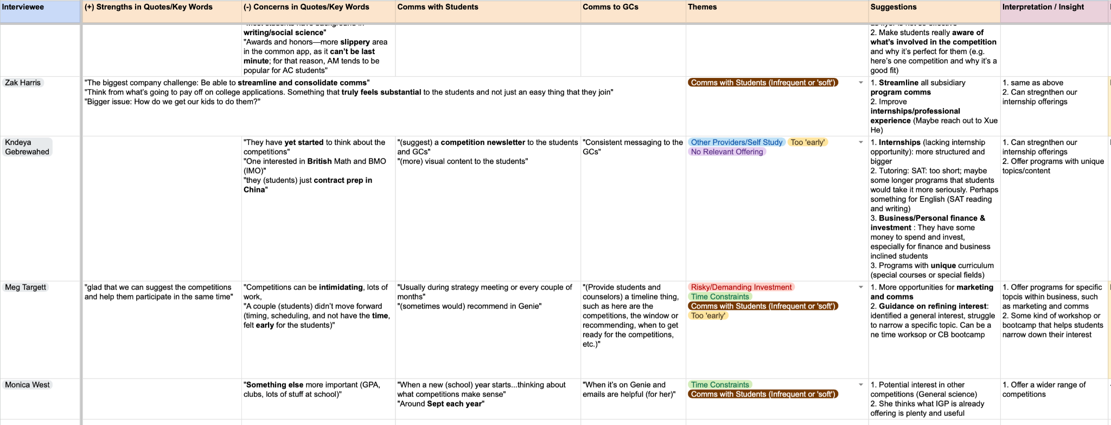
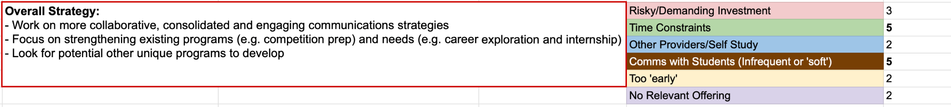
Feedback Meetings with Counseling Team

Slide 5
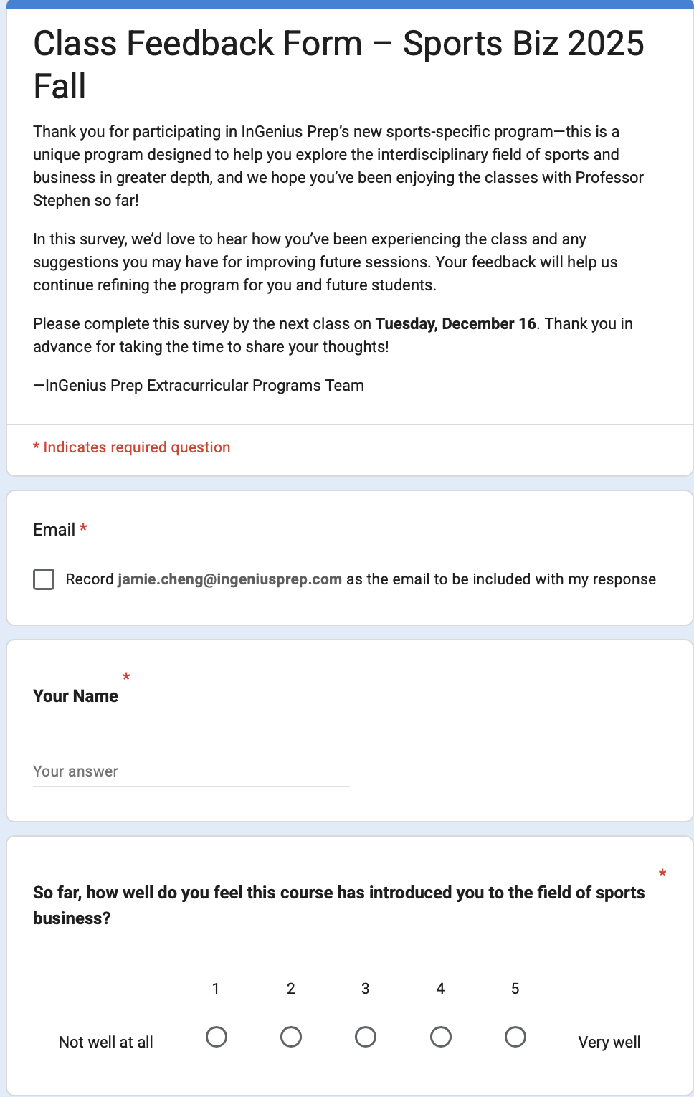
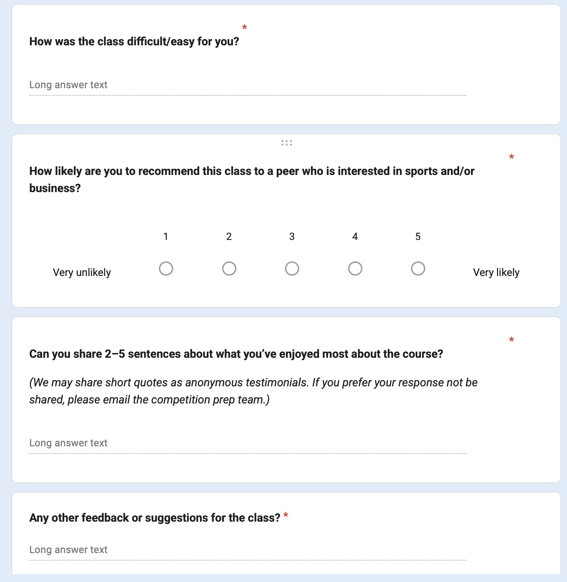
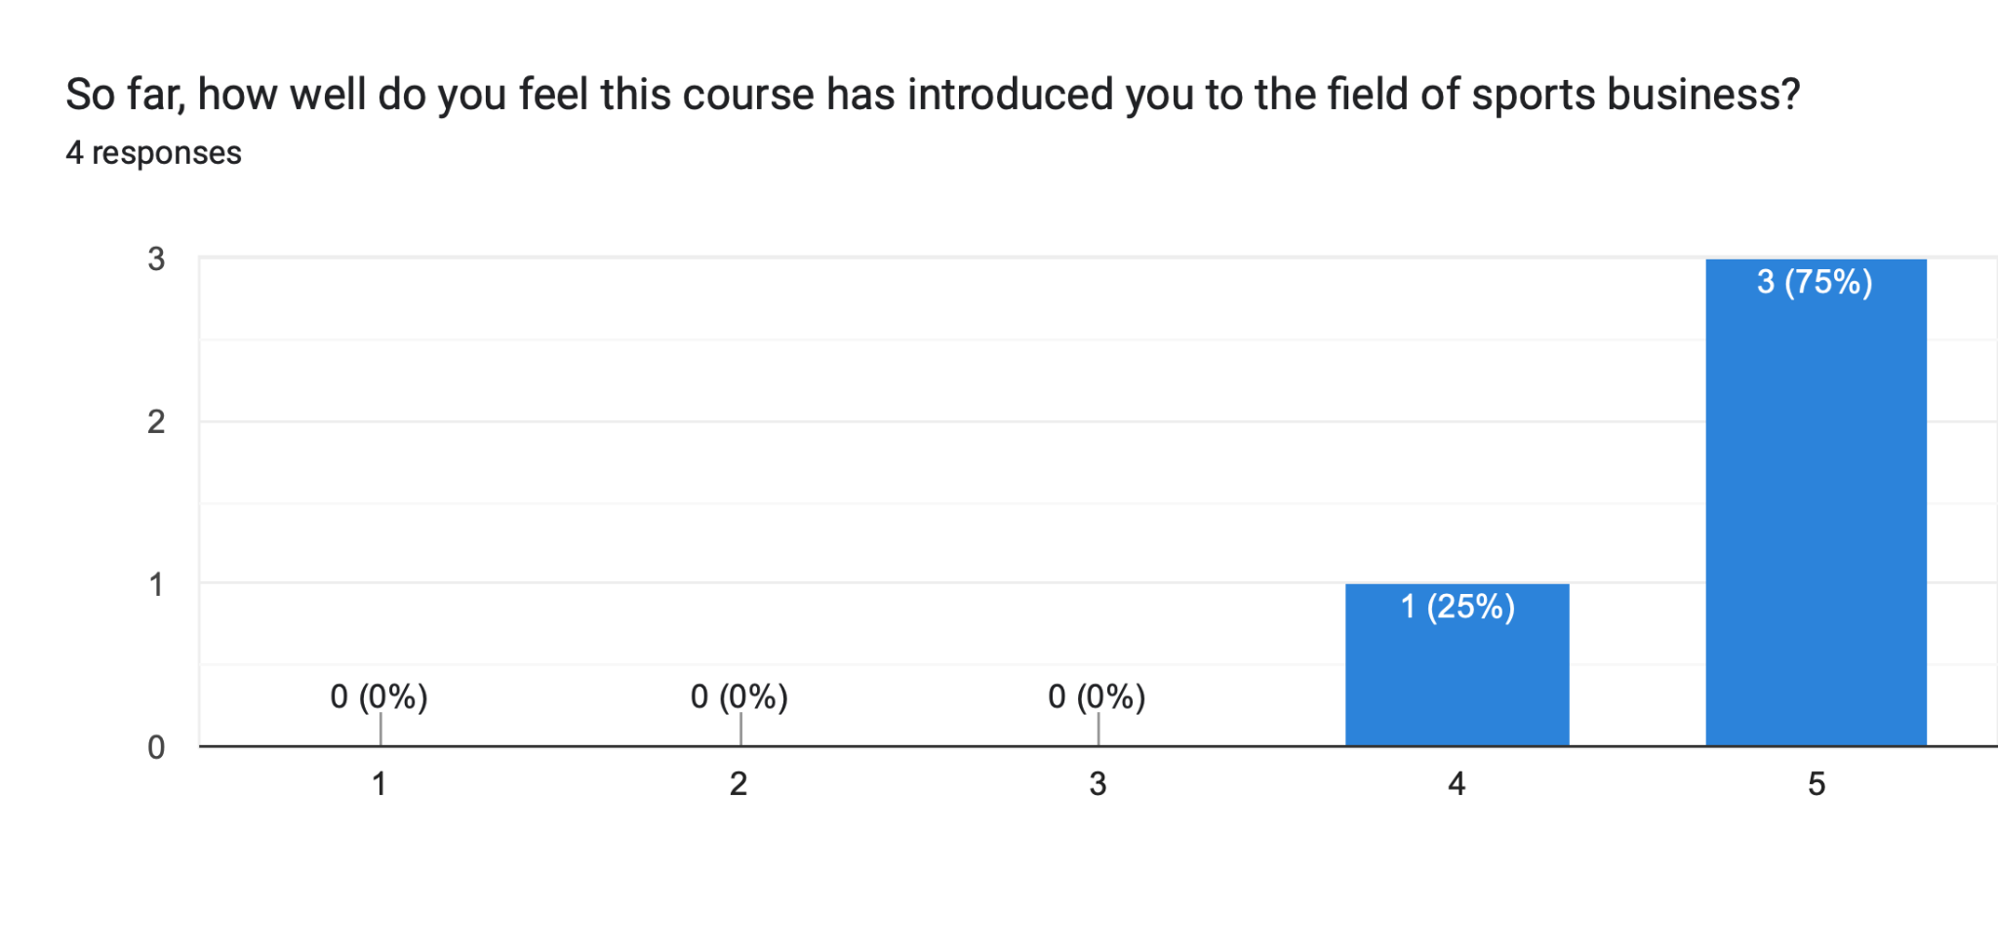
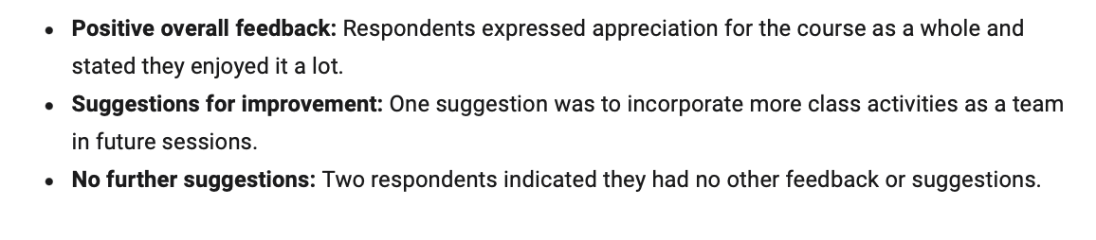
Survey Development & Analysis

